Slide 1
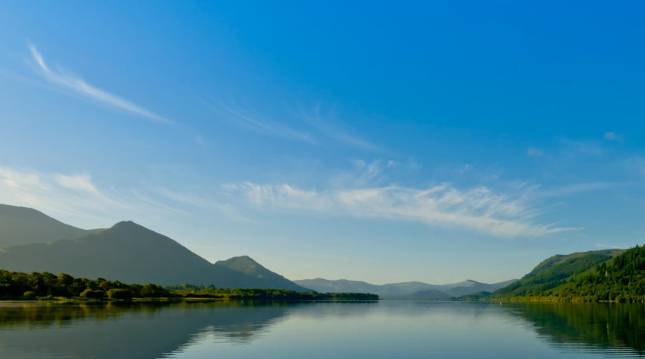






Assessing the impact of river barriers on successful seaward migration of Atlantic salmon, Salmo salar along the River Derwent, Cumbria.
Amy Green, Hannele Honkanen & Colin Adams
Notes:
Hi, my name is Amy Green, I am a second year PhD student at the university of glasgow. I have completed my first research season in 2020 assessing the impact of river barriers on successful seaward migration of Atlantic salmon salmo salar along the river Derwent in Cumbria.
Today I am going to share some findings from the 2020 study primarily of the impact of natural standing waters and environmental factors impacting migration.

Slide 2
Atlantic Salmon Life-Cycle
NASCO 2019
Notes:
So, in spring and fall Atlantic Salmon adults migrate to their natal rivers to spawn where they lay eggs on clean gravel bed in fast flowing rivers. Atlantic salmon are iteroparous which means they spawn multiple times throughout their life time.
The young which are called salmon fry spend their first few years of life feeding on invertebrates in fast shallow flowing rocky streams.
After spending two to three years in the river the young salmon parr changes its body chemistry and becomes a silvery fish that is known as a smolt and migrates to sea.
The highest rates of mortality are thought to occur during the smolt stage since they are undergoing the physiological stress due to morphological changes that allow them to adapt to the marine environment.

Slide 3
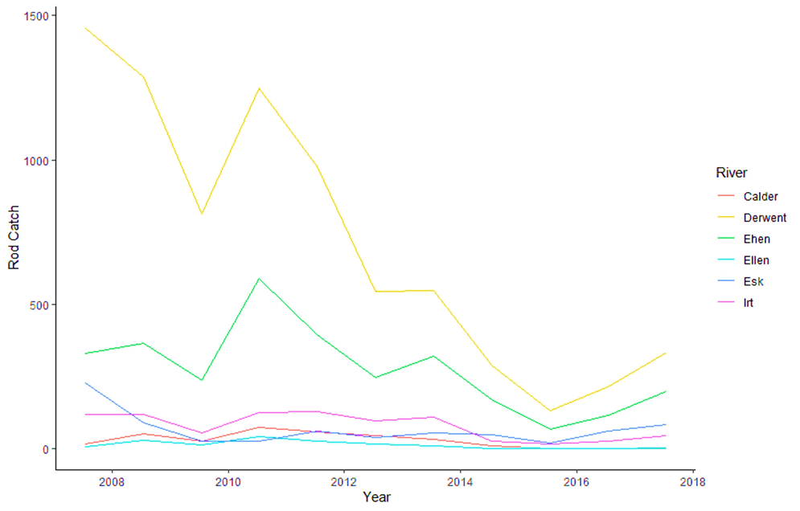
Cumbria Catchment reduction
S. salar have been listed in annexes II and V of the European Union’s Habitats Directive as a species of European importance
Atlantic salmon has been categorized as a Priority Species under the UK Post-2010 Biodiversity Framework.
Rod Catches:
Data collected throughout the catchment 2007-2017.
Derwent rod catches of Atlantic salmon have declined by 77% across 10 years.
Since 2015 a small increase has been found (unknown reason).
Notes:
The Atlantic Salmon serves both cultural, ecological and economic importance.
They have been categorized a priority species under the UK post 2010 Biodiversity Framework.
My Project will be focusing on the River Derwent in the Cumbria catchment.
Rod catch data collected by the environment agency throughout 2007-2017 along various rivers within the Cumbria catchment clearly shows Atlantic salmon numbers are declining.
Derwent = 77% reduction across the 10 year data collection period. Though there has been a slight increase in rod catches since 2015 though this reason is unknown.
You would commonly assume rivers in the same catchment would experience similar environmental pressures and similar numbers though this is clearly not the case.
The environment agency know how many smolts are caught in the smolt trap and they know how many adults are coming back. However, they don't know what happens between those two points.
There is a large volume of research that has been conducted analysing a variety of threats to migrating salmonids.
Though the river Derwent is one of few river systems that have such a high level of both natural and anthropogenic issues. Often research published has been conducted in Scottish river/lake systems, though there is currently no research to date analysing the river Derwent and impact of both natural and anthropogenic issues on salmonids.

Slide 4
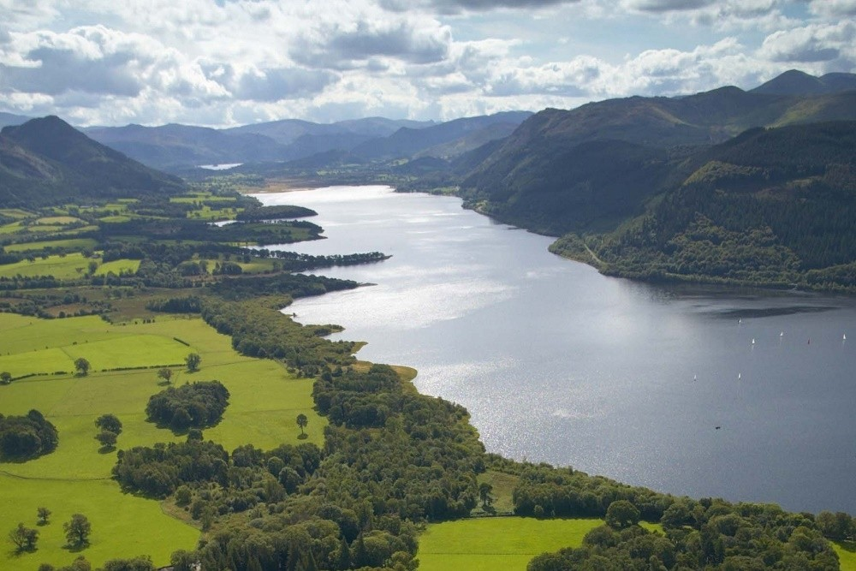
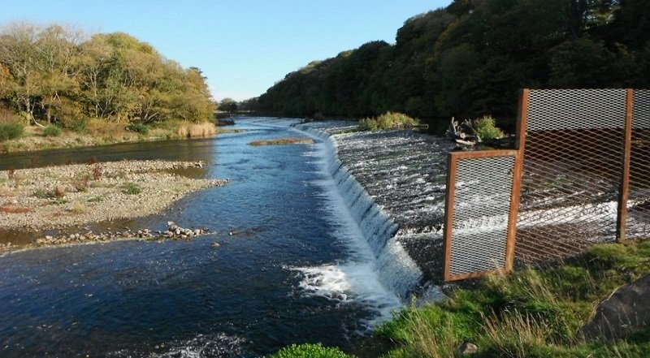
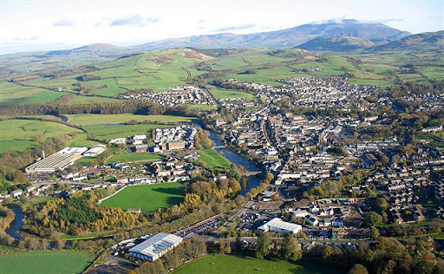
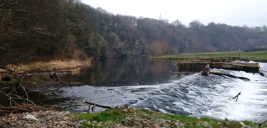
Natural and Human Built River Threats Along River Derwent
Bassenthwaite Lake
Yearl Weir
Urbanised areas- Keswick, Cockermouth & Workington
Coops Weir
Notes:
Here are a few examples of the main river barriers individuals face along the river Derwent .
Past research has shown large standing waters lack directional water currents.
Juvenile salmonids go with the flow often , where they rely on flow cues to initiate migration, so reduced cues can confuse individuals. Thus, making this a substantially large threat.
low-head weirs not only restrict fish populations’ essential life stage movements but also increase habitat impact by altering downstream flux of essential water, temperature, sediment and nutrient movements within river ecosystems . Increased movement and searching behaviors when looking for a passage route are most likely to incur energy expenditure costs caused by the impassable river obstructions and can both impede complete passage or just prolong migration.
Migration through urbanised areas has received attention due to its potential to disrupt diel migratory patterns of Atlantic salmon due to increased artificial light pollution.
Migration success of Atlantic has previously been linked to lunar brightness and successful entry into marine environments which frequently occurs at night.
Currently in England only 11% of the environment typically experience truly dark nights.

Slide 5
Aims and Objectives
Aim to evaluate the migration costs on this population across natural and anthropogenic river threats.
Notes:
Aim to evaluate the migration costs on this population across natural and man-made river barriers. An acoustic telemetry approach will be used to gather data on migration behaviour and success across stress inducing barriers through surgically implanted transmitters and continuous monitoring acoustic receivers.

Slide 6
Aims and Objectives
The objective of the study is to understand and close the knowledge gaps in smolt migration literature and the evidence found will be used to potentially enable future management strategies to be implemented.
1) What are the habitat specific costs of migration?
2) Determine if what environment factors (water flow, water temperature, cloud coverage, wind direction/speed, moon phase, rain fall) influence migration success and duration throughout the River Derwent?
3) Do low-head weir obstruction increase the cost of migration (through delays or mortality)? Or influence choice in migration direction?
4) Determine if individuals exhibit different migration patterns through standing waters? Is migration through standing waters unidirectional? Is migration through standing water slower than in rivers?
Notes:
The objective of the study is to understand and close the knowledge gaps in smolt migration literature and the evidence found will be used to potentially enable future management strategies to be implemented.
1) What are the habitat specific costs of migration?
2) Determine if what environment factors (water level, water temperature, cloud cover, wind speed/direction and water flow) influence migration success throughout the River Derwent.
3) Do low-head weir obstruction increase the cost of migration (through delays or mortality)? Or influence choice in migration direction?
4) Determine if individuals exhibit different migration patterns through standing waters? Is migration through standing water slower than in rivers? Is migration through standing waters unidirectional?
WEIRS ARE THE MAIN FOCUS OF PHD BUT DON’T HAVE DATA FROM 2020

Slide 7
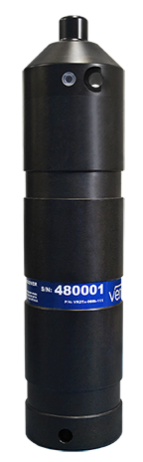
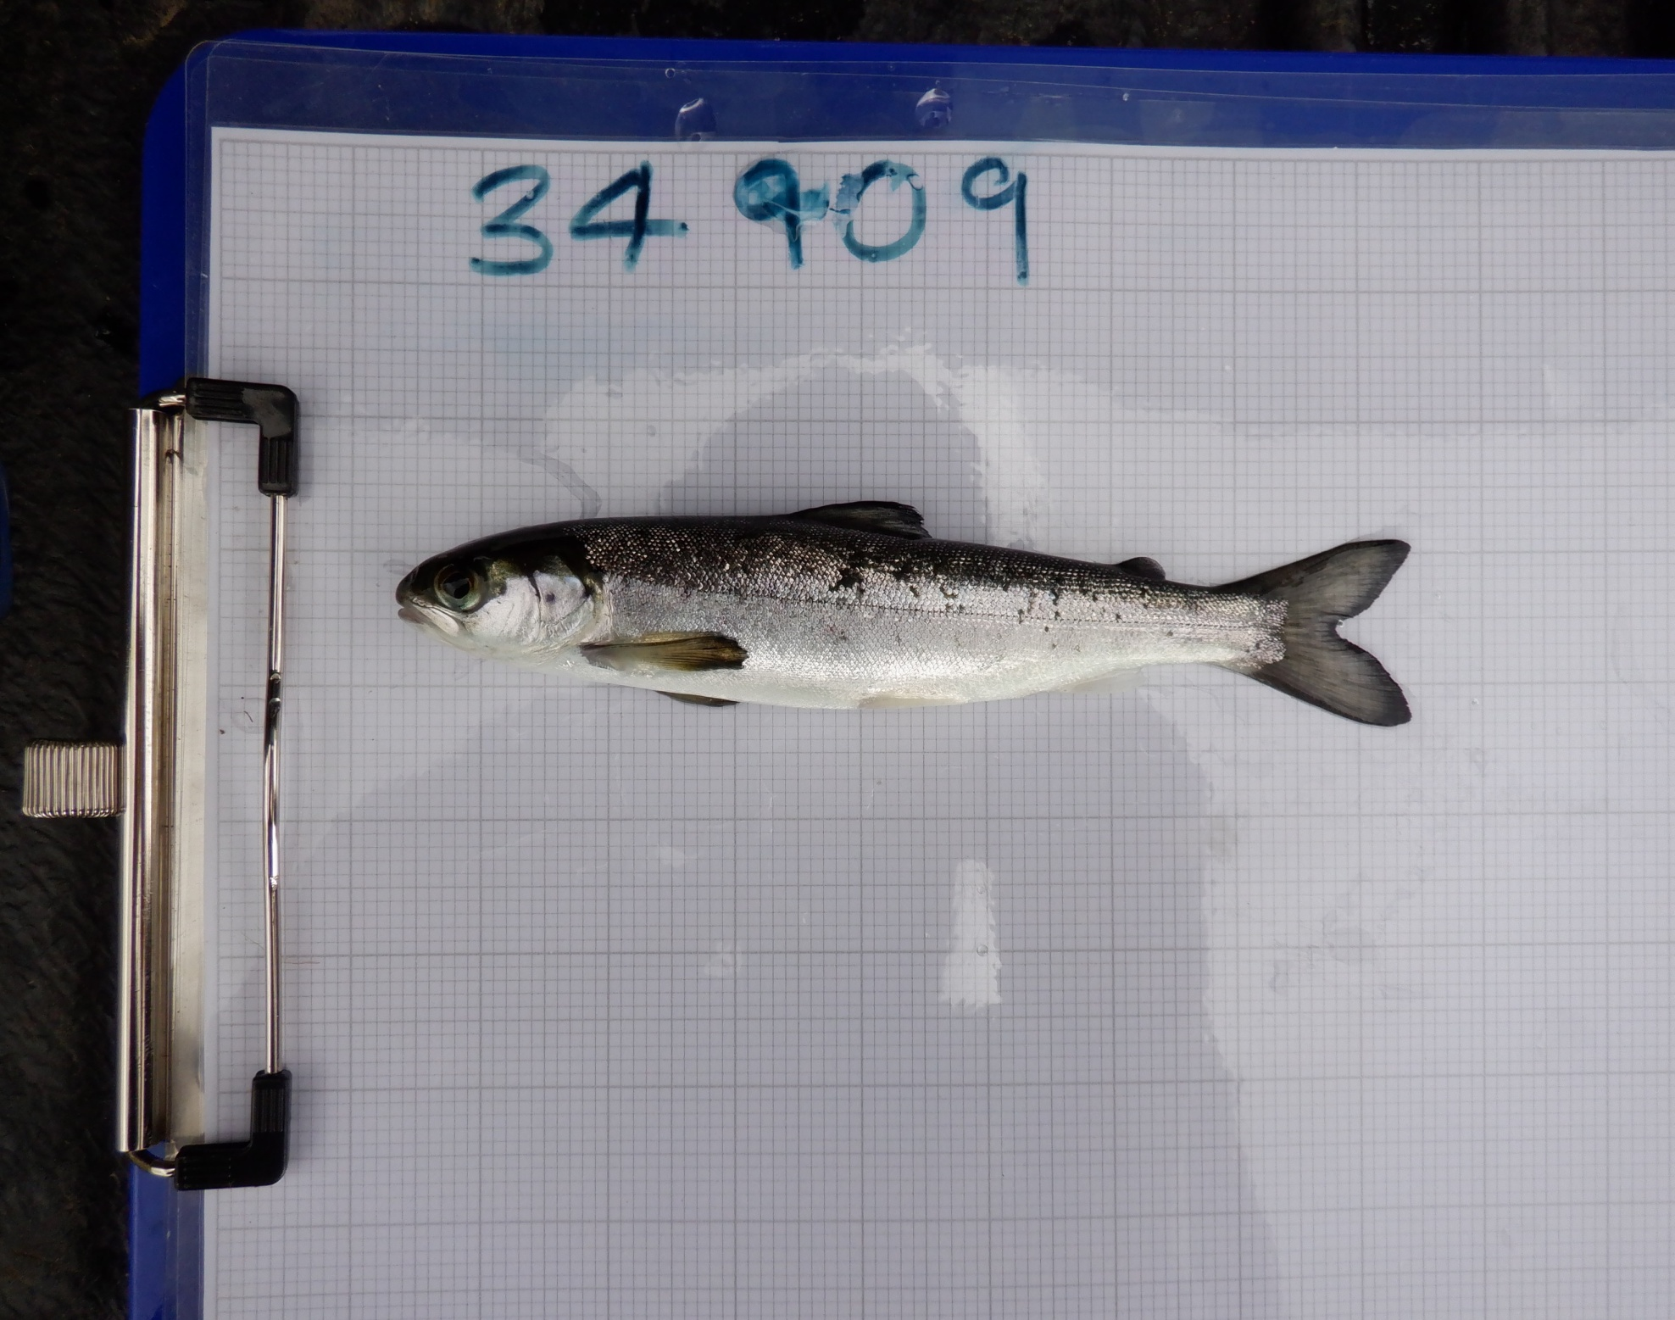
Acoustic Tagging Technology
69 kHz
VEMCO
Transmission: ~ 30 ms
Nominal delay: 45 sec
Notes:
Acoustic telemetry uses sound waves through water to allow individual migration patterns to be observed. This involves a tag, which when passing a receiver be give off a sound wave signal, in which the receiver will pick up. This provides timestamp data for that individual.
For the 2020 study each smolt was inserted with a V7- 69Khz tag, with a nominal delay on 45secs.
All data from the receiver can be downloaded at a later date providing date and time and which individual was within a receiver's area, which can aid in understanding individual behaviour throughout their migration.
Its is best to note now, not all tag signals are picked up by receivers due to a variety of reasons such as turbulent waters, smolt speed and additional noise caused by recreational water activities.

Slide 8
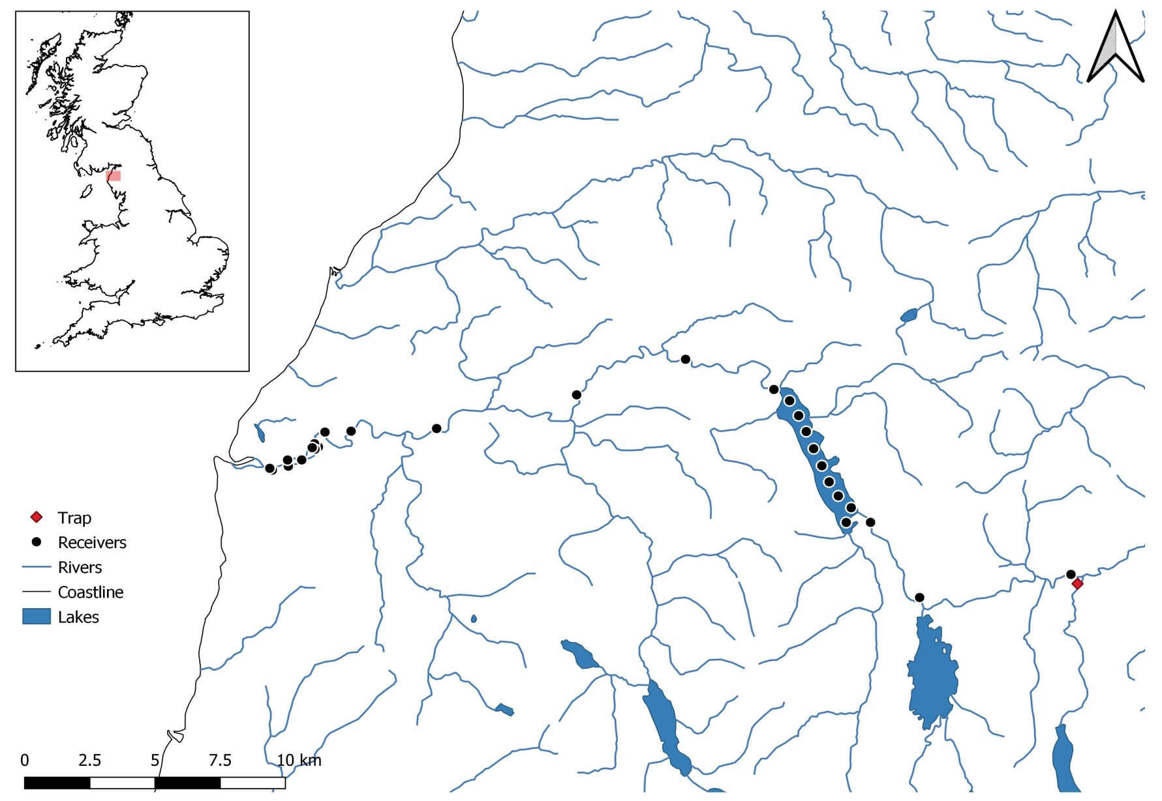
Study Site
The River Derwent, Cumbria, North-West England, (catchment; 100 km²) supports a population of Atlantic salmon.
Notes:
The study site extends 50km from the tagging site at st johns beck to the Workington harbour.
27 receivers were placed along various points throughout the river Derwent where threats had been established.
For Analysis, the river will be split into 3 sections to:
• St Johns Beck through to the entrance to Bassenthwaite
This is where initial migration occurs, passing through the urbanised area of Keswick and migrating into the Bassenthwaite lake.
• Bassenthwaite lake
Which is a large 4mile standing water, which could impose a threat
• Bassenthwaite exit to Workington harbour
Passing through a designated SAC area, urbanised areas of cockermouth and Workington and initiating migration across weirs and into Workington harbour.

Slide 9
Receiver Deployment and Tagging
River receivers were deployed on the 10th March 2020 and collected on the 26th July 2020 = 15
Bassenthwaite receivers were deployed on the 11th March 2020 and collected on the 26th August 2020 = 9 Total
Stolen receivers=1
Missing receivers= 1
Not retrieved= 2
100 Atlantic salmon smolts were tagged during May 1st - 3rd 2020
Notes:
Tagged with home office license training

Slide 10
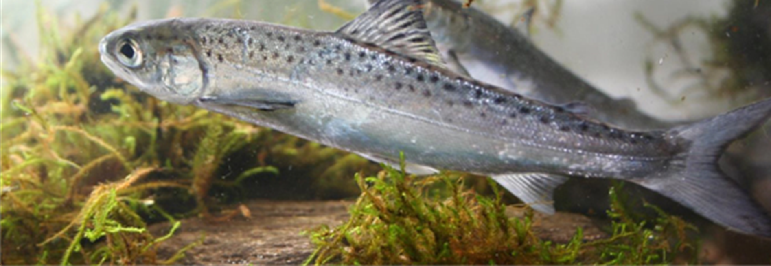
Results

Slide 11
1) What are the habitat specific costs of migration?
Section | Distance (km) | Survival | Mortality | Mortality per/km | Duration (hrs) | Average ROM
1 | 12.52 | 32 | 68 | 5.43 | 321.3 | 0.012
2 | 7.15 | 15 | 17 | 2.37 | 52.2 | 0.063
3 | 29.45 | 8 | 7 | 0.23 | 68.4 | 0.070
Notes:
As you can see section 1 experiences 68% tag loss. Section 1 is a short distance and clearly the high mortality per km in this short section indicates something is going on within the area in comparison to section 3. Time spent migrating through section 1 was almost triple the migrating time of section 3.
The Bassenthwaite, is also an area which requires more investigation as migration slowed down throughout this system. Individuals took almost the same amount of time as section 3 though the Bassenthwaite was a much smaller area in comparison. Mortality per/km in the Bassenthwaite was also relatively high in comparison with it the section size thus something must be occurring in this area.
In total only 8 individuals were deemed successful, allowing us to assume they made it out of the Workington harbour and into the Irish sea to migrate north to key feeding grounds.

Slide 12

2) What environment factors (water level, water temperature, cloud cover, wind speed/direction and water flow) influence migration success and duration throughout the River Derwent?
Section | GLM study question | Number of individuals | Environmental predictors
Section 1 | Duration | n=32 | Wind Direction Rain Fall Water Flow Moon Phase [waning gibbous]
 | Survival | n=100 | Wind Direction Wind Speed Air Temperature Water Flow
Section 2 | Duration | n=15 | Wind Direction Wind Speed Cloud Coverage Rain Fall Water Flow Moon Phase [full moon]
 | Survival | n=32 | Moon Phase [waning gibbous]
Section 3 | Duration | n=8 | Cloud Coverage Rain Fall Water Flow Moon Angle Length
 | Survival | n=15 | Wind Direction Water Flow Moon Angle Tag Burden
Notes:
So in order to investigate environmental factors influencing migration success and duration, I looked a variety of factors such as:
Wind Direction and speed
Rain Fall
Water Flow
Air and Water temperature
Cloud coverage
Moon phase or angle
Length
Tag burden
Weight
I conducted statistical analysis using GLM’s and separated each section into survival and duration
Please note for duration I could only use individuals which made it from the start of a section to the end successfully migrating into the next section.
Survival analysis was conducted by giving an individual 1 if they were successful through the section or 0 if there was tag loss.
As you can see water flow was found in influence across all sections. Water flow in the first section was extremely low when tagging so we expected this in section 1.
Wind speed in section 2 was found to extremely high which may have contributed to to the migration delay and caused average duration to be increase.
I am still investigating a lot of these variables so hopefully with 2021 data it will be interesting to see how each infulencing variable differs.

Slide 13
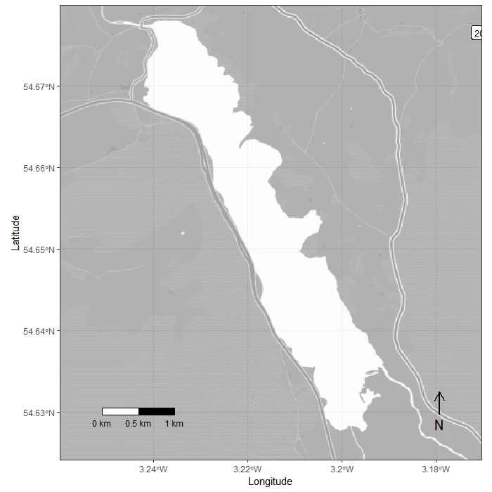
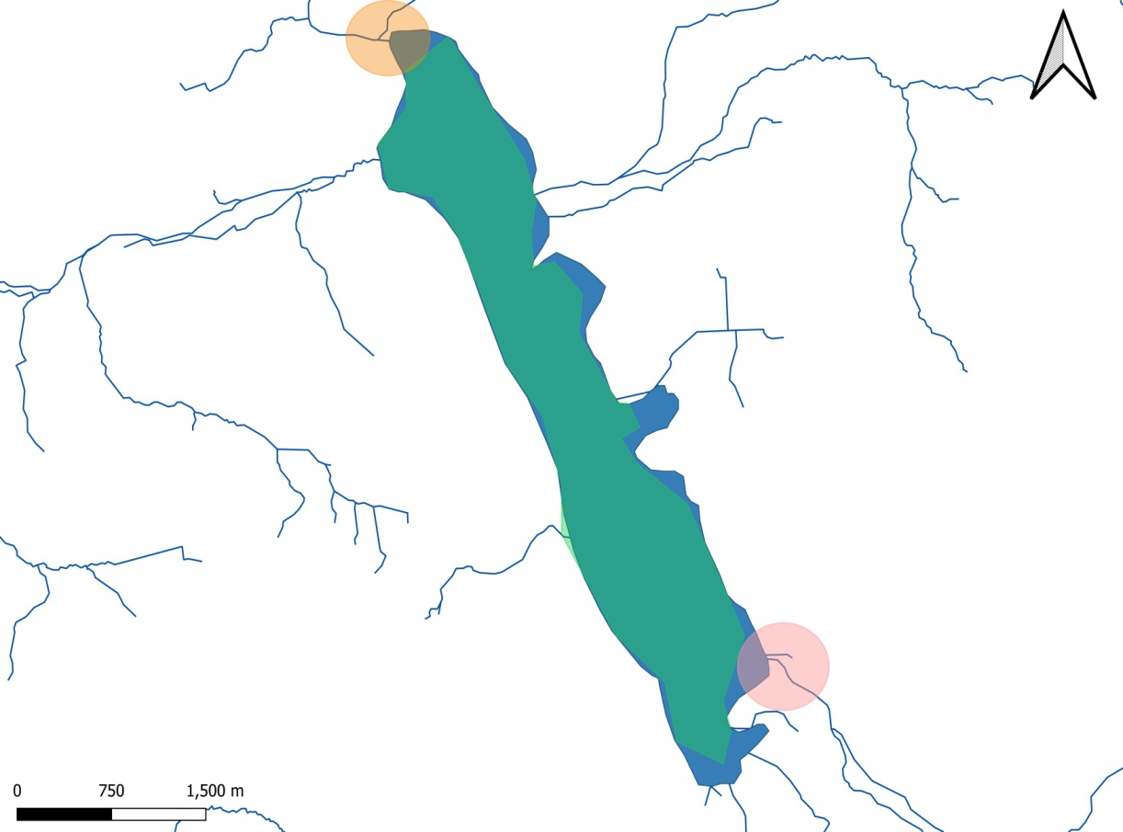
4) Determine if individuals exhibit different migration patterns through standing waters? Is migration through standing waters unidirectional? Is migration through standing water slower than in rivers?
10%
48%
50%
A3
Notes:
Our analysis found Bassenthwaite to be a hot spot for rapid back and forth movements and we wanted to see which section tag loss was most prevalent.
64 individuals made it to A3, though only 50% of this total (32) migrated into the Bassenthwaite. From the 32 individuals that migrated into the lake there was a further 48% tag loss throughout the middle section and a further 10% tag loss at the exit point. Leaving 15 individuals.
We were surprised at where tag loss was highest as we anticipated the exit point to be a hot spot for this due to it being a designated Special area of conservation for a variety of species including predatory birds.
We noticed there was a high level of directional change at the top end of the Bassenthwaite
Many smolts made it to the very top receiver of the Bassenthwaite and turned around, though we still don’t have evidence to conclude what might be the cause of this, which requires future investigation.
On average it took an individual 52 hours to migrate successful through the lake system at an average speed of 0.063 m/s, the river system when comparing against section 3 it took individuals 86 hour on average to migrate at a speed of 0.070m/s to the irish sea. Though section 3 was 4x longer than the Bassenthwaite, therefore migration through standing waters is slower than in rivers based on the section length comparison.

Slide 14
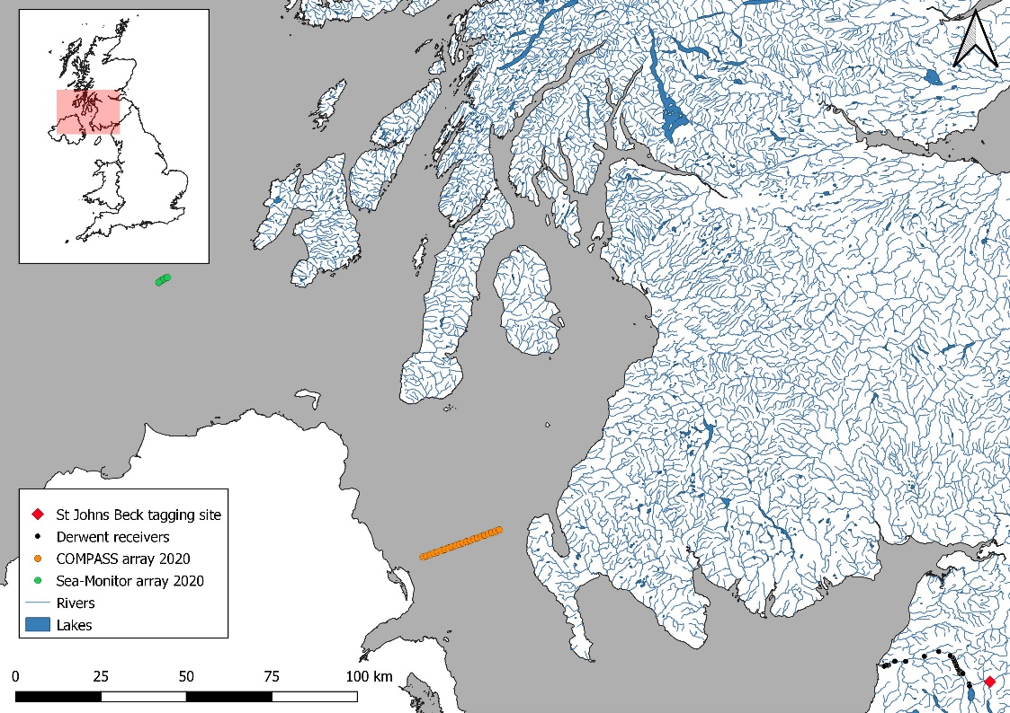
Sea Array Detections 2020
Notes:
In addition to river tracking, there are other projects analysing marine migration through the Irish sea. An example of two projects are COMPASS and Sea monitor. Both project managed to get two deep sea arrays out which can be seen in the map.
The compass array which is the orange line of receivers (approximately 138km from the final Derwent receiver), managed to detect two of the 8 successful salmon smolts from the river Derwent (34946 & 34988) . It took between 6-9 days for the individuals to reach this array. The receivers were placed 1km apart from each other with a detection range of ~300m therefore it is possible for individuals to go by undetected.
Another individual (34920) was later detected on the sea monitor array. This individual took 10 days to travel from the last Derwent receiver to the array, across 262km. Which is currently the furtherest tracked salmon smolt in Europe to date.

Slide 15
Conclusion
Are there habitat specific costs to migration?
Do environmental factors influence migration success and duration throughout the river Derwent?
Do each section experience different influencing environmental factors?
Do individuals exhibit different migration patterns through standing waters?
Is migration through standing waters unidirectional?
Is migration through standing water slower than in rivers?
YES
YES
YES
YES
NO
YES

Slide 16
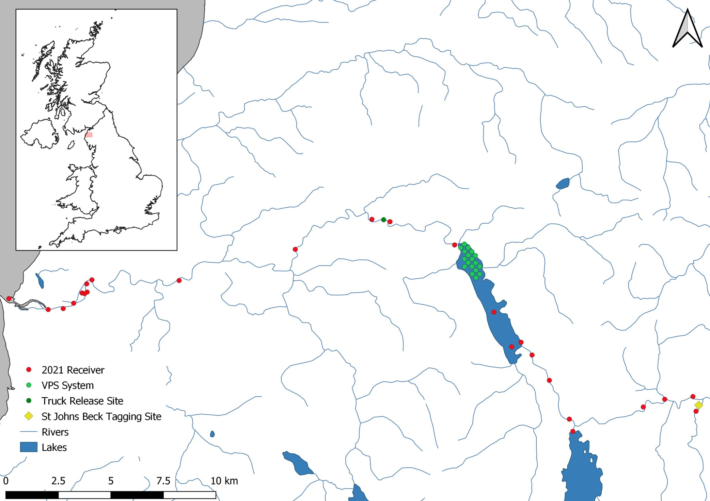
2021 Study
Notes:
For 2021, we acknowledged from the 2020 results that section 1 had a high level tag loss rate therefore, we have decided to increase the receiver density across this section to hopefully pinpoint areas in which tag loss is occurring.
we are also really interested in understanding the directional movements within the Bassenthwaite therefore we have designed a VPS system which is a cluster of receivers which will allow us to analyse small scale movements where directional change occurred at the exit of the Bassenthwaite.
Also to ensure more salmon smolts make it down to the weirs at Workington, we have planned to explore a potential management strategy by tagging fish at st johns beck, transporting them past the Bassenthwaite to the village isle and releasing from there. The 2020 study showed not enough individuals made it to the weirs to do much data analysis on therefore we aim to increase the density of fish making it to this section and this will hopefully provide statistical evidence of weir impact on Derwent populations.

Slide 17
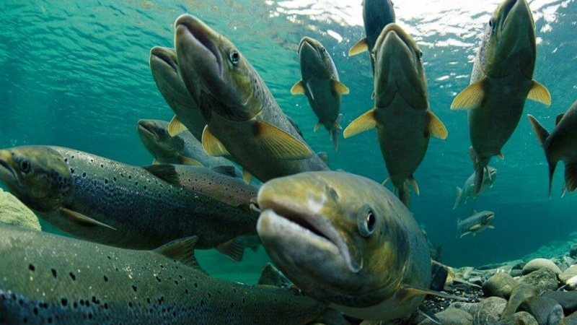
Thank you for listening
Any Questions?

